Slide 1

CUSTOMER RETENTION ANALYSIS
By
C. B. Karthik

Slide 2
Table Of Contents :-
1. Introduction
1.1 What is customer retention?
1.2 Background of the Problem
2. Top 5 benefits of customer retention
3. Data analysis
4. Conclusion
5. Limitation of the dataset and scope for future work

Slide 3
INTRODUCTION
What is customer retention?
Retention analysis (or survival analysis) is the process of analyzing user metrics to understand how and why customers churn.
Retention analysis is key to gain insights on how to maintain a profitable customer base by improving retention and new user acquisition rates.
By running consistent retention analysis, what will we achieve:
Reason why customers are churning.
At what point of time the customers are more likely to leave.
How does churning affect our bottom line.
Strategies to follow to improve retention strategies.

Slide 4
Background of the Problem
Keeping your current customers happy is generally more cost-effective than acquiring first-time customers.
According to the Harvard Business Review, acquiring a new customer can be 5 to 25 times more expensive than holding on to an existing one.
There is not need to spend big on marketing, advertising or sales outreach.
It is easier to turn existing customers into repeating ones, since they already trust your brand from previous purchases.
New customers, however, often require more convincing when it comes to that initial sale. Customer loyalty won't just give you repeat business.
Loyal customers are more likely to give free recommendations to their colleagues, friends and family.
Creating that cycle of retained customers and buzz marketing is one way the company can cultivate customer loyalty for long-term success

Slide 5
Top 5 benefits of customer retention
Reducing the cost of customer acquisition as the cost to acquire new customers is very high compared to retaining old Customers
Increasing the value of each sale
Gaining insight into your customers
Building referrals and loyalty
Reducing customer churn

Slide 6
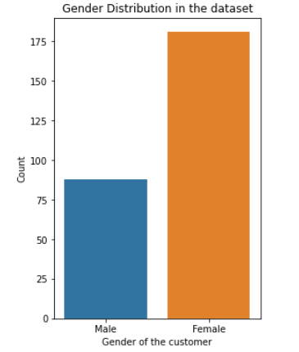

Data analysis
Univariate analysis: Gender of the Customer
Observation:
Majority, 181 of the customers are Female whereas Male are 88.
There are more female customers compared to men customers who made purchases

Slide 7
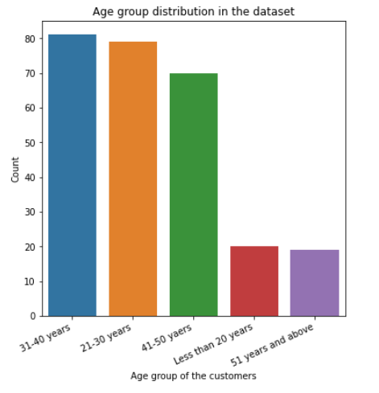
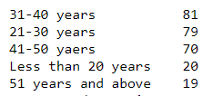
Univariate analysis: Gender of the Customer
Observation:
Majority of the customers are from age group 31-40 years.
60% of purchases are made by customers aged between 20 – 40yrs

Slide 8
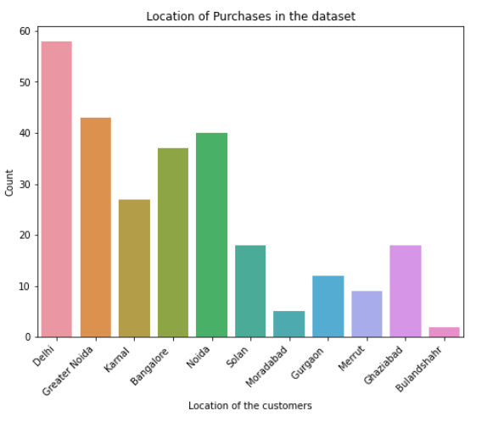
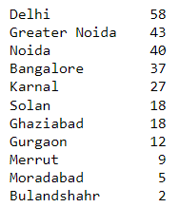
Univariate analysis: Location of the Customer
Observation:
The highest purchases were made from Delhi followed by Greater Noida, Noida and Bangalore and Bulandshar with the least number of purchases

Slide 9
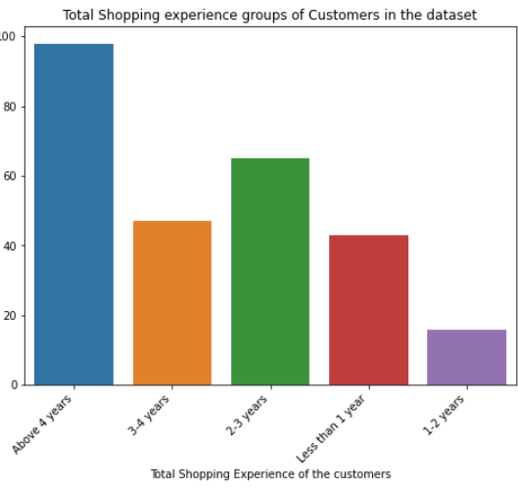

Univariate analysis: Experience of the Customer
Observation:
50% of the customers have experience in online purchases more than 3 years

Slide 10
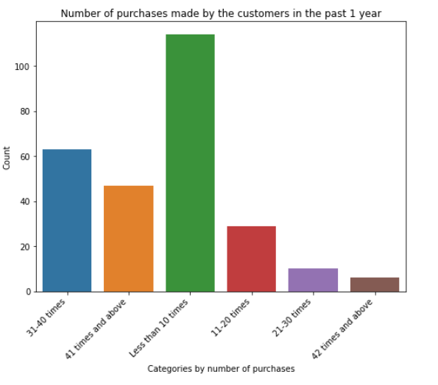
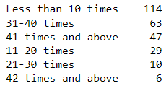
Univariate analysis: Experience of the Customer in last 1 year
Observation:
57% of people purchased less than 30 times over the last year

Slide 11
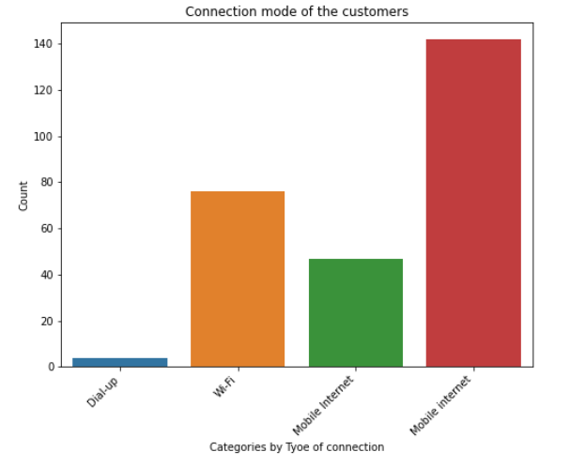

Univariate analysis: Connection mode used by the Customer
Observation:
70% of customers used mobile internet during their purchases 28% used WIFI and 2% used dialup connections to make purchases

Slide 12
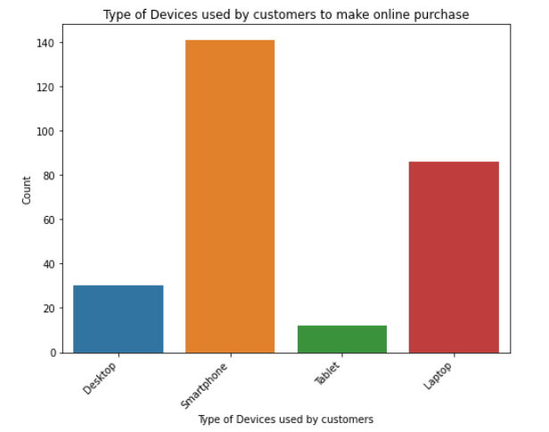

Univariate analysis: Devices used by the Customer
Observation:
57% of purchases were through mobiles (52%) and tablets (5%) and rest 43% was made through laptops and desktops

Slide 13
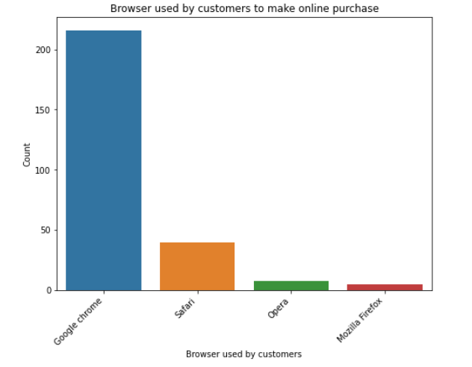

Univariate analysis: Browser used by the Customer
Observation:
81% of purchases were done through Google Chrome, 15% through Safari Browser and 4% through Opera and Firefox

Slide 14
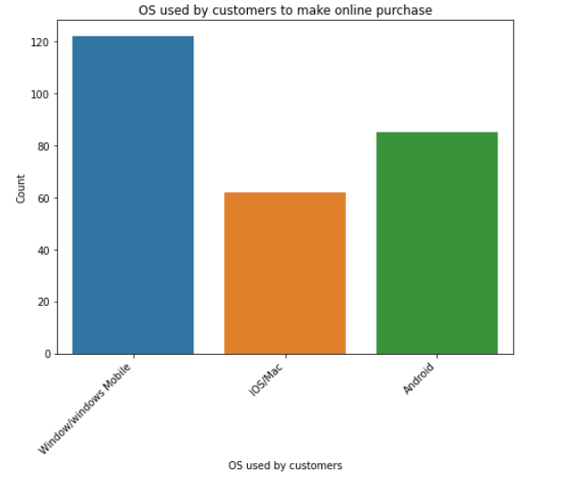

Univariate analysis: OS used by the customers
Observation:
45% of customers used Windows/windows devices to make purchases 32% through Android and 23%through IOS/MAC

Slide 15
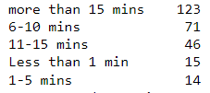

Univariate analysis: Time spent by the customers before making the purchase
Observation:
63% of Customers spend a minimum of 10 mins on the website/application browsing before making the actual purchase while 11% spend less than 5 mins.
Univariate analysis: Preferred payment method of the customers
Observation:
55% of the customers prefer to use either credit or debit cards to make purchase while 28% chose Cod as an option and remaining 17% use wallets.

Slide 16


Univariate analysis: Importance of recommended similar product info
Observation:
77% of the customers feel that the products for comparison should have complete info of that product
Univariate analysis: Preferred payment method of the customers
Observation:
91% of the customers feel that the User Interface i.e., the contents of the web page must be easy to read and understand

Slide 17
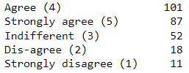
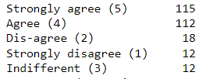
Univariate analysis: Importance of seller and complete product info
Observation:
70% of the customers believe that they would prefer the complete details f the seller and the product to be listed before they decide to make any purchase. Out of this 46% of them strongly believe that these details are very much needed for making a purchase.
Univariate analysis: Speed of the website/application response
Observation:
84% of the customers feel that the loading and the processing time of the website or the application has an impact on the purchase decision. A slow website/application brings down the interest of the customer.

Slide 18


Univariate analysis: Easy Payments
Observation:
89% of the customers feel that easy and convenient payment methods have a high impact on purchases. Easier the payment methods higher the excitement of the customer towards purchases
Univariate analysis: Privacy of the Customer Information
Observation:
90% of the customers are of the opinion that they tend to purchase products from sellers who are obliged to maintain the privacy of the customer

Slide 19


Univariate analysis: Service availability of the Seller
Observation:
90% of the customers are of the opinion that they tend to purchase products from sellers who are able to provide service through various modes of communication.
Univariate analysis: Convenience and flexibility of Online Shopping
Observation:
83% of the customers fee that they prefer to shop online because it is more convenient and flexible

Slide 20


Univariate analysis: Quality of the website
Observation:
97% of the customers feel that the quality of the website has more effect on the purchases. A good quality website attracts more customers and thereby encourage them to make purchases
Univariate analysis: Effect of wide variety of products in each category
Observation:
76% of customers need more varieties in each category of products

Slide 21
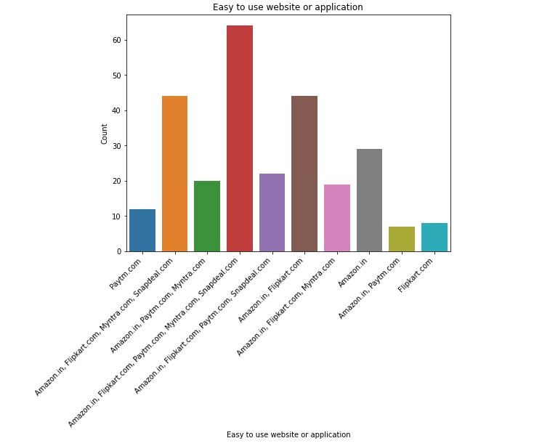
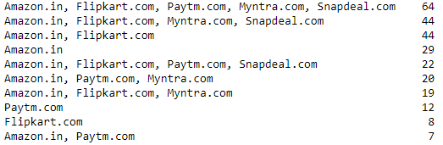
Univariate analysis: Service availability of the Seller
Observation:
Amazon.in, Flipkart.com, Paytm.com, Myntra.com, Snapdeal.com are the easiest to use websites

Slide 22
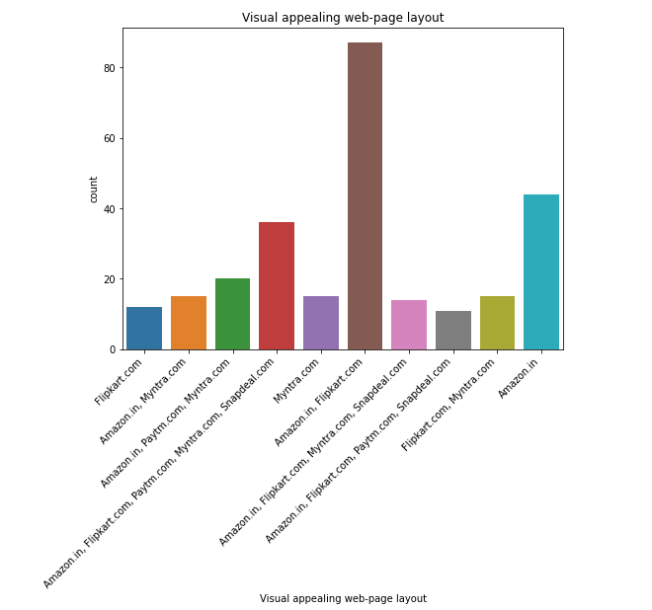
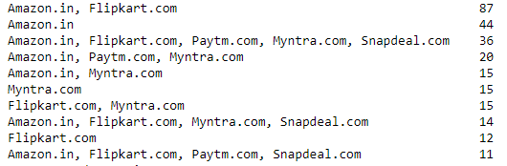
Univariate analysis: Most Visually appealing web-page layout
Observation:
Amazon.in, Flipkart.com are the website which are more visually appealing to the customers

Slide 23
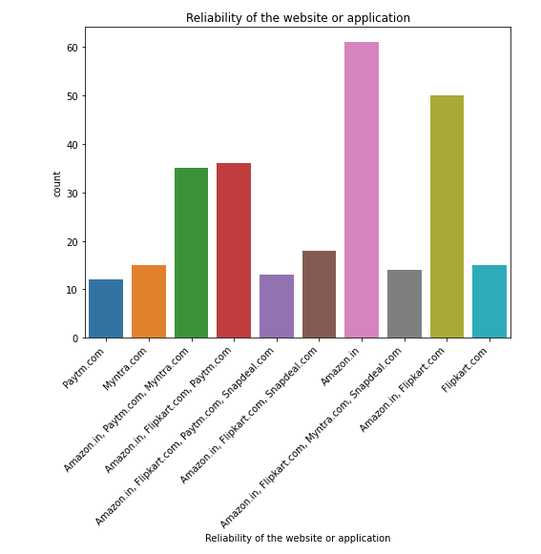
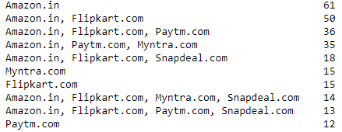
Univariate analysis: Reliability of the website / application
Observation:
Most of the customers fee that Amazon is the most reliable website to shop with followed by Flipkart and Paytm

Slide 24
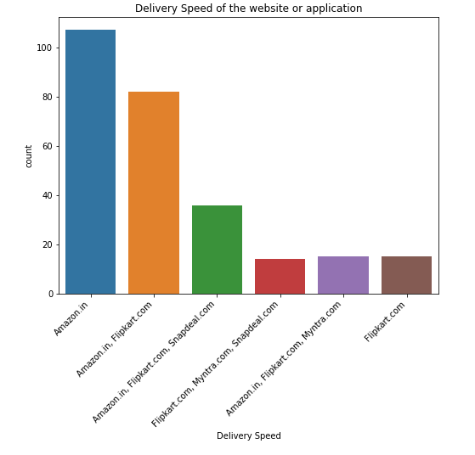
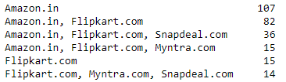
Univariate analysis: Delivery Speed of the Seller
Observation:
Most of them are of the opinion that Amazon has the highest delivery speed among all the websites

Slide 25
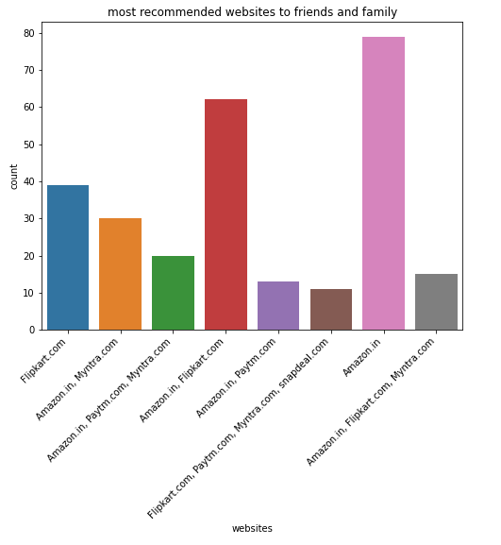
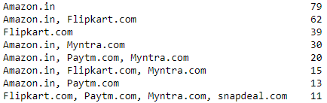
Univariate analysis: Recommendation to Friends/Family
Observation:
Amazon is the website that the customers feel that they would recommend it to their friends and family.

Slide 26
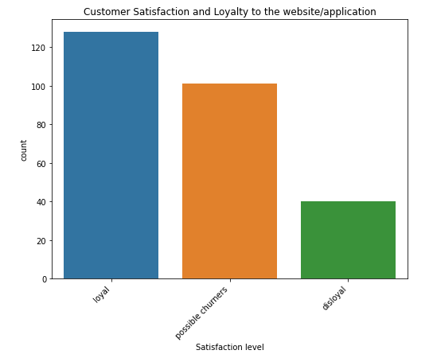
Segmentation of Customers based on their Loyalty to the App/ Website/ Seller
Observation:
I have segmented the customers based on their loyalty. Anyone with satisfaction level 4 and above are loyal, anyone with satisfaction level 2 and below are disloyal and anyone with satisfaction level 3 as possible churners

Slide 27
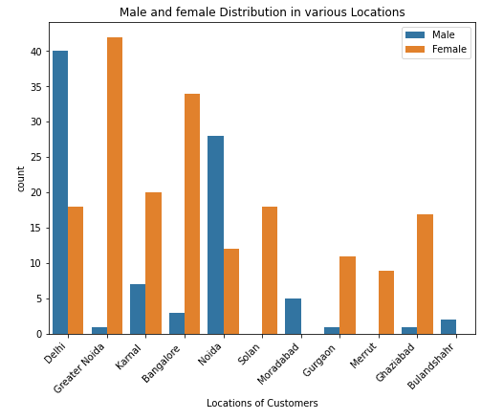
Distribution of Customers gender over different Locations
Observation:
The number of female customers is on a higher note in all locations except Delhi, Noida, Moradabad and Bulandshahr

Slide 28
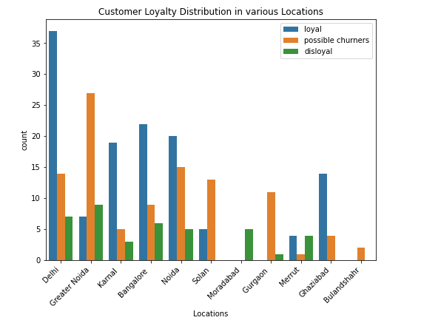
Distribution of Customers Loyalty over different Locations

Slide 29
Conclusion
Customer Retention is the most effective way to grow a business and it is one of the keys to success.
Acquiring new customers are always more expensive and takes more effort than retaining them.
Therefore it is crucial for business, to try to keep the retention rate up, with the tips mentioned here or more, in order to have better conversion rates, lower marketing costs, and higher profits.

Slide 30
Limitations of this dataset and Scope for Future Work
The size of the dataset being very small, may lead to bias of the insights drawn.
The dataset has only 269 observations collected over a large geographical area (entire country).
If we try to make data driven decisions from the given dataset, we might not be able to come to a proper conclusion which exactly reflects the actual reality.
Scope for future work:
Collect more samples evenly covering the entire geographical area to make sure that the dataset is not imbalanced

